Slide 1
Functions

Slide 2
Declaration of function
Syntax:
type function_name(argument(s));
Here, type specifies the type of value returned
Function name specifies name of user-defined function
Bracket argument(s) specifies the arguments supplied to the function as comma separated list of variable. If there are no arguments, then the bracket is left empty.
The declaration is also called as prototype of function.
Example:- int sum( int x,int y ); // take two integer and return integer value
void printmessage(); //take no argument and no return value

Slide 3
Definition of function
we can say that the collection of functions creates a program.
Syntax:
type function_name(argument(s))
{
statement(s);
}
The statement(s) within {} symbols indicate the body of a function. here, the actual logic of the work of function is implemented.
If the return type is not mentioned, then by default it is taken as int.we can not define function inside function but we can call one function to another.
If function return type is other than void, there must be return statement in the function.

Slide 4
Advantage of functions in C
By using functions, we can avoid rewriting same logic/code again and again in a program.
We can call C functions any number of times in a program and from any place in a program.
We can track a large C program easily when it is divided into multiple functions.
Reusability is the main achievement of C functions.

Slide 5
aspects of FUNCTIONS
There are three aspects of a C function.
Function declaration: A function must be declared globally in a c program to tell the compiler about the function name, function parameters, and return type.
Function call: Function can be called from anywhere in the program. The parameter list must not differ in function calling and function declaration. We must pass the same number of functions as it is declared in the function declaration.
Function definition: It contains the actual statements which are to be executed. Here, we must notice that only one value can be returned from the function.

Slide 6
SN | C function aspects | Syntax
1 | Function declaration | return_type function_name (argument list);
2 | Function call | function_name (argument_list)
3 | Function definition | return_type function_name (argument list) { function body; }

Slide 7
Types of Functions
There are two types of functions in C programming:
Library function:
These function are the built-in functions i.e., they are predefined in the library of the C. These are used to perform the most common operations like calculations, updatation, etc. Some of the library functions are printf, scanf, sqrt, etc. To use this functions in the program the user have to use associate header file associated to the corresponding function in the program.
For Example:
If, the user have to use print the data or scan the data using input stream then we have to use functions printf() and scanf() in C program. To use these functions the user have to include #include <stdio.h> preprocesser directive in C program.

Slide 8
2)User defined function:-
These functions are designed by the user when they are writing any program because for every task we do not have a library of functions where their definitions are predefined. To perform the according to the requirement of user the user have to develop some functions by itself, these functions are called user-defined functions. For such functions the user have to define the proper definition of the function.
void findSum (int a, int b)
{
printf("Sum is: %d", a + b);
}int main()
int a = 3, b = 5;
findSum (a, b); // Function Call
Output:
Sum is: 8

Slide 9
User-defined Functions | Library Functions
These functions are not predefined in the Compiler. | These functions are predefined in the compiler of C language.
These function are created by user as per their own requirement. | These functions are not created by user as their own.
User-defined functions are not stored in library file. | Library Functions are stored in special library file.
There is no such kind of requirement to add the particular library. | In this if the user wants to use a particular library function then the user have to add the particular library of that function in header file of the program.
Execution of the program begins from the user-define function. | Execution of the program does not begin from the library function.
Example: sum(), fact(),…etc. | Example: printf(), scanf(), sqrt(),…etc.

Slide 10
Parameters
The parameter is referred to as the variables that are defined during a function declaration or definition. These variables are used to receive the arguments that are passed during a function call. These parameters within the function prototype are used during the execution of the function for which it is defined. These are also called Formal arguments or Formal Parameters.
Example: Suppose a Mult () function is needed to be defined to multiply two numbers. These two numbers are referred to as the parameters and are defined while defining the function Mult().

Slide 11
Function Arguments
If a function is to use arguments, it must declare variables that accept the values of the arguments. These variables are called the formal parameters of the function. Formal parameters
behave like other local variables inside the function and are created upon entry into the function and
destroyed upon exit.
Parameter
A parameter is a special kind of variable, used in a function to refer to one of the pieces of data provided as input to the function to utilise. These pieces of data are called arguments. Parameters are Simply Variables.

Slide 12
Formal Parameter
Parameter Written in Function Definition is Called “Formal Parameter.
Formal parameters are always variables, while actual parameters do not have to be variables.
Actual Parameter
Parameter Written in Function Call is Called “Actual Parameter”.
One can use numbers, expressions, or even function calls as actual parameters.
Example
void display(int para1)
{
printf( “ Number %d “ , para1);
}
void main()
{ int num1;
display(num1);
}
para1 is called the Formal Parameter
num1 is called the Actual Parameter.

Slide 13
Argument | Parameter
When a function is called, the values that are passed during the call are called as arguments. | The values which are defined at the time of the function prototype or definition of the function are called as parameters.
These are used in function call statement to send value from the calling function to the receiving function. | These are used in function header of the called function to receive the value from the arguments.
During the time of call each argument is always assigned to the parameter in the function definition. | Parameters are local variables which are assigned value of the arguments when the function is called.
They are also called Actual Parameters. | They are also called Formal Parameters

Slide 14
Scope of variable
In what part of the program the variable is accessible is dependent on where the variable is declared. there are two type of scope:
local variable:
The variable declared inside the body of function is called local variable for that function.
These variable cannot be accessed outside the function in which they are declared.
So far we have used all the variable as local because all the variable were declared inside of either main() function or inside user defined function.
Global variable:
The variable which are declared outside my function definition is called as global variable.
These variable accessible by all the function in that program.

Slide 15
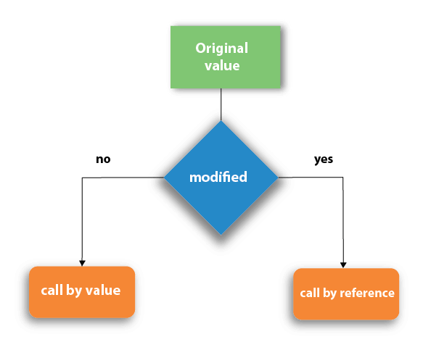
Passing parameters
There are two methods to pass the parameters into the function in C language, i.e., call by value and call by reference.

Slide 16
Call by value vs call by reference
In call by value, argument values are passed to the function, the content of actual parameter are copied into the formal parameters.
In call by value method, we can not modify the value of the actual parameter by the formal parameter.
In call by value, different memory is allocated for actual and formal parameters.
The actual parameter is the argument which is used in the function call whereas formal parameter is the argument which is used in the function definition.

Slide 17
void change(int num) {
Printf ("Before adding value inside function num=%d \n",num);
num=num+100;
printf("After adding value inside function num=%d \n", num);
}
int main() {
int x=100;
printf("Before function call x=%d \n", x);
change(x);//passing value in function
printf("After function call x=%d \n", x);
return 0;
}
Before function call x=100
Before adding value inside function num=100
After adding value inside function num=200
After function call x=100

Slide 18
In call by reference, the address of the variable is passed into the function call as the actual parameter.
The value of the actual parameters can be modified by changing the formal parameters since the address of the actual parameters is passed.
In call by reference, the memory allocation is similar for both formal parameters and actual parameters. All the operations in the function are performed on the value stored at the address of the actual parameters, and the modified value gets stored at the same address.

Slide 19
void change(int *num) {
printf("Before adding value inside function num=%d \n",*num);
*num = *num+ 100;
printf("After adding value inside function num=%d \n", *num);
}
int main() {
int x=100;
printf("Before function call x=%d \n", x);
change(&x);//passing reference in function
printf("After function call x=%d \n", x);
return 0;
}
Before function call x=100
Before adding value inside function num=100
After adding value inside function num=200
After function call x=200

Slide 20
CATEGORIES OF FUNCTION
Function with no arguments and no return value.
Function with arguments but no return value.
Function with no arguments and return value.
Function with arguments and return value.

Slide 21
Function with no arguments and no return value.
#include<stdio.h>
void sum();/////FUN DECLARATION
void main()
{
sum();////FUN CALLING
getch();
}
void sum()////FUN DEFINITION
{
int a,b,sum;
printf(“Enter two integers:”);
scanf(“%d%d”,&a,&b);
sum=a+b;
printf(“The sum of two numbers is %d”,sum);
}

Slide 22
Function with arguments but no return value
#include<stdio.h>
void sum(int , int );////function declaration
void main()
{
int a,b;
printf(“Enter two integers:”);
scanf(“%d%d”,&a,&b);
add(a,b);///function calling
getch();
}
void add(int x, int b)////function definition
{
sum=a+b;
printf(“The sum of two numbers is %d”,sum);
}

Slide 23
Function with no arguments and return value
#include<stdio.h>
int sum();///function declaration
void main()
{
int x;
x=sum();///function calling
printf(“The sum of two numbers is %d”,x);
getch();
}
int sum()///function definition
{
int a,b;
printf(“Enter two integers:”);
scanf(“%d%d”,&a,&b);
return(a+b);
}

Slide 24
Function with arguments and return value
#include<stdio.h>
int sum(int a , int b);///function declaration
void main()
{
int a,b,sum;
printf(“Enter two integers:”);
scanf(“%d%d”,&a,&b);
Sum=add(a,b);///function calling
printf(“The sum of two numbers is %d”,sum);
getch();
}
int add(int x, int y)////function definition
{
Int result; result=x+y;
Return result;
}

Slide 25
Recursion
Recursion is the process of repeating items in a self-similar way. In programming languages, if a program allows you to call a function inside the same function, then it is called a recursive call of the function.
Recursion is the process by which a function calls itself. Because the function calls itself , there must be some condition to stop recursion; otherwise it will lead to infinite loop.
Example syntax:
void recursion()
{
recursion();///function calls itself///
}
void main()
{
recursion();
}
Recursive functions are very useful to solve many mathematical problems, such as calculating the factorial of a number, generating Fibonacci series, etc.

Slide 26
Working of recursion

Slide 27
Number Factorial
Calculates the factorial of a given number using a recursive function.
#include <stdio.h>
int factorial(int i) {
if(i <= 1) {
return 1;
}
return i * factorial(i - 1);
}
void main() {
int i;
printf("enter number");
scanf("%d",&i);
printf("Factorial of %d is %d\n", i, factorial(i));
}
Output:
enter number2
Factorial of 2 is 2

Slide 28
Types of recursion:
Direct Recursion
Indirect Recursion

Slide 29
Direct Recursion
A function fun is called direct recursive if it calls the same function fun.
An example of direct recursion:
void directRecFun()
{
// Some code....
directRecFun();
// Some code...
}

Slide 30
Indirect recursion
A function fun is called indirect recursive if it calls another function say fun_new and fun_new calls fun directly or indirectly.
An example of indirect recursion:
void indirectRecFun1()
{
// Some code...
indirectRecFun2();
// Some code...
}
void indirectRecFun2()
{
// Some code...
indirectRecFun1();
// Some code...
}

Slide 31
Advantages and Disadvantages of Recursion
Advantages:
Easy solution for recursively defined problems.
Complex programs can be easily written in less code.
Disadvantages:
Recursive code is difficult to understand and debug.
Terminating condition is must, otherwise it will go in infinite loop.
Execution speed decreases because of function call and return activity many times.

Slide 32
Macros and Preprocessing
.

Slide 33
Macros
A macro is a piece of code in a program that is replaced by the value of the macro.
Macro is defined by #define directive.
Whenever a macro name is encountered by the compiler, it replaces the name with the definition of the macro.
Macro definitions need not be terminated by semi-colon(;).
C program to illustrate macros
#include <stdio.h>
// Macro definition
#define LIMIT 5
// Driver Code
void main()
{
// Print the value of macro defined
printf("The value of LIMIT is %d", LIMIT);
}
OUTPUT: The value of LIMIT is 5

Slide 34
Types of Macros
Object-like macros
Chain macros
Multi-line macros
Function-like macros

Slide 35
Object-like macros
An object-like macro is a simple identifier which will be replaced by a code fragment.
It is called object-like because it looks like an object in code that uses it.
It is popularly used to replace a symbolic name to numerical/variable represented as constant.
// C program to illustrate macros
#include <stdio.h>
// Macro definition
#define DATE 31
// Driver Code
int main()
{
// Print the message
printf("Lockdown will be extended upto %d-MAY-2020",DATE);
return 0;
}
OUTPUT:Lockdown will be extended upto 31-MAY-2020

Slide 36
Chain macros
Macros inside macros are termed as chain macros.
In chain macros first of all parent macro is expand then child macro is expanded.
// C program to illustrate macros
#include <stdio.h>
// Macro definition
#define INSTAGRAM FOLLOWERS
#define FOLLOWERS 138
// Driver Code
int main()
{
// Print the message
printf(“Salman have %dK followers on Instagram", INSTAGRAM);
return 0;
}
OUTPUT: Salman have 138K followers on Instagram

Slide 37
Multi-line macros
An object-like macro could have a multi-line.
So to create a multi-line macro you have to use backslash-newline.
// C program to illustrate macros
#include <stdio.h>
// Multi-line Macro definition
#define ELE 1, \
2, \
3
void main()
{
// Array arr[] with elements // defined in macros.
int arr[] = { ELE };
printf("Elements of Array are:\n"); // Print elements
for (int i = 0; i < 3; i++) {
printf("%d ", arr[i]);}
}
OUTPUT:-Elements of Array are:
1 2 3

Slide 38
Function-like macros
These macros are the same as a function call.
It replaces the entire code instead of a function name.
Pair of parentheses immediately after the macro name is necessary.
If we put a space between the macro name and the parentheses in the macro definition then the macro will not work.
// C program to illustrate macros
#include <stdio.h>
// Function-like Macro definition
#define min(a, b) (((a) < (b)) ? (a) : (b))
// Driver Code
int main()
{
// Given two number a and b
int a = 18;
int b = 76;
printf("Minimum value between %d and %d is %d\n", a, b, min(a, b));
}
Output:
Minimum value between 18 and 76 is 18

Slide 39
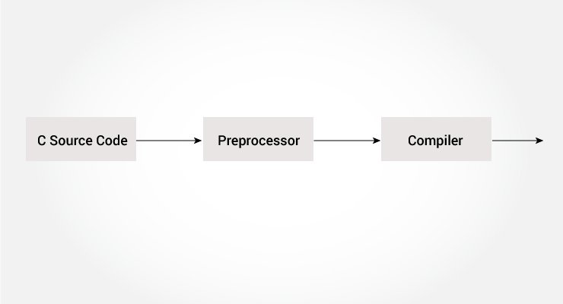
Preprocessing
Working of Preprocessor
These are the pre-processor in c ,#include, #define etc..
The C preprocessor is a macro preprocessor (allows you to define macros) that transforms your program before it is compiled.
These transformations can be the inclusion of header file, macro expansions etc.

Slide 40
Preprocessing
All preprocessing directives begin with a # symbol. For example,
#define PI 3.14
Including Header Files: #include
The #include preprocessor is used to include header files to C programs. For example,
#include <stdio.h>
Here, stdio.h is a header file. The #include preprocessor directive replaces the above line with the contents of stdio.h header file.
That's the reason why you need to use #include <stdio.h> before you can use functions like scanf() and printf().

Slide 41
Macros using #define
A macro is a fragment of code that is given a name. You can define a macro in C using the #define preprocessor directive.
Here's an example.
#define d 299792458 // speed of light
Here, when we use d in our program, it is replaced with 299792458.

