Slide 1
Fundamentals of Structures and Unions.

Slide 2
Structures.
Arrays allow to define type of variables that can hold several data items of the same kind.
Similarly structure is another user defined data type available in C that allows to combine data items of different kinds.
The struct statement defines a new data type, with more than one member.
To define a structure, you must use the struct keyword.
At the end of the structure's definition, semicolon is must to declare.
Why use structure?
In C, there are cases where we need to store multiple attributes of an entity. It is not necessary that an entity has all the information of one type only. It can have different attributes of different data types.
For example, an entity Student may have its name (string), roll number (int), marks (float).

Slide 3
Structure declaration
There are two ways to declare structure variable:
By struct keyword within main() function
By declaring a variable at the time of defining the structure.

Slide 4
By struct keyword within main() function
Example to declare the structure variable by struct keyword. It should be declared within the main function.
struct employee
{
int id;
char name[50];
float salary;
};
Now write given code inside the main() function.
void main(){
struct employee e1, e2; }
The variables e1 and e2 can be used to access the values stored in the structure.

Slide 5
By declaring a variable at the time of defining the structure.
Syntax of structure:
struct [structure tag] {
member definition;
member definition;
...
member definition;
} [one or more structure variables];
Example to declare variable at the time of defining the structure.
struct employee
{ int id;
char name[50];
float salary;
}e1,e2;

Slide 6
Declaration
If number of variables are not fixed, use the 1st approach. It provides you the flexibility to declare the structure variable many times.
If no. of variables are fixed, use 2nd approach. It saves your code to declare a variable in main() function.

Slide 7
Initialization of structure
Initialization members(variable) order should be same .
Example :
#include<stdio.h>
struct car
{
char name[100];
float price;
};
void main()
{
// car1.name -> "xyz"
//car1.price -> 987432.50
struct car car1 ={"xyz", 987432.50};
//printing values using dot(.) or 'member access' operator
printf("Name of car1 = %s\n",car1.name);
printf("Price of car1 = %f\n",car1.price);
}

Slide 8
Initialization of structure
Example initialization
struct employee
{ int id;
char name[50];
float salary;
};
Now write given code inside the main() function.
Void main(){
struct employee e1[20], e2[20];
.
.
.}

Slide 9
Accessing members of the structure
The link between a member and variable is established using the member operator(.).which is also know as dot operator.
Example:
e1.name
How we would assign values to the members of employee.
(1). strcpy(e1.name,”abc”);
e1.id=123;
(2). scanf(“%s”,e1.name);
scanf(“%s”,e1.id);

Slide 10
Array of structure
An array of structures in C can be defined as the collection of multiple structures variables where each variable contains information about different entities. The array of structures in C are used to store information about multiple entities of different data types. The array of structures is also known as the collection of structures.
Example:
struct student{
int rollno;
char name[10];
};
int main(){
int i;
struct student st[5];
.
.
.

Slide 11
#include<stdio.h>
#include <string.h>
struct student{
int rollno;
char name[10];
};
int main(){
int i;
struct student st[5];
printf("Enter Records of 5 students");
for(i=0;i<5;i++){
printf("\nEnter rollno:");
scanf("%d",&st[i].rollno);
printf("\nEnter name:");
scanf("%s",&st[i].name);
}
printf("\nStudent Information List:");
for(i=0;i<5;i++){
printf("\nRollno:%d, Name:%s",st[i].rollno,st[i].name);
}
return 0;
}

Slide 12
Nested Structure
C provides us the feature of nesting one structure within another structure by using which, complex data types are created.
For example, we may need to store the address of an entity employee in a structure. The attribute address may also have the subparts as street number, city, state, and pin code. Hence, to store the address of the employee, we need to store the address of the employee into a separate structure and nest the structure address into the structure employee.

Slide 13
#include<stdio.h>
struct address
{
char city[20];
int pin;
char phone[14];
};
struct employee
{
char name[20];
struct address add;
};
void main ()
{
struct employee emp;
printf("Enter employee information?\n");
scanf("%s %s %d %s",emp.name,emp.add.city, &emp.add.pin, emp.add.phone);
printf("Printing the employee information....\n");
printf("name: %s\nCity: %s\nPincode: %d\nPhone: %s",emp.name,emp.add.city,emp.add.pin,emp.add.phone);
}

Slide 14
UNION
Union can be defined as a user-defined data type which is a collection of different variables of different data types in the same memory location.
The union can also be defined as many members, but only one member can contain a value at a particular point in time.
Syntax:
union [union tag] {
member definition;
member definition;
...
member definition;
} [one or more union variables];
Example:
union Data {
int i;
float f;
char str[20];
} data;

Slide 15
Size of the union
The size of the union is based on the size of the largest member of the union.
Example.
union abc{
int a;
char b;
float c;
double d;
};
int main()
{
printf("Size of union abc is %d", sizeof(union abc));
return 0;
}
the size of int is 4 bytes, size of char is 1 byte, size of float is 4 bytes, and the size of double is 8 bytes. Since the double variable occupies the largest memory among all the four variables, so total 8 bytes will be allocated in the memory. Therefore, the output of the above program would be 8 bytes.

Slide 16
Accessing and initialization of union
#include <stdio.h>
#include <string.h>
union Data {
int i;
float f;
char str[20];
};
int main( ) {
union Data data;
data.i = 10;
data.f = 220.5;
strcpy( data.str, "C Programming");
printf( "data.i : %d\n", data.i);
printf( "data.f : %f\n", data.f);
printf( "data.str : %s\n", data.str);
return 0;
}

Slide 17
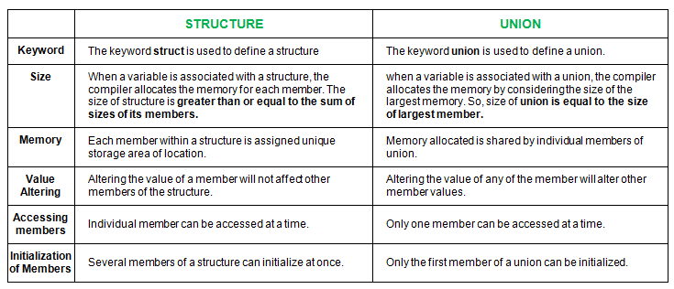
Difference between structure and union

